Slide 1
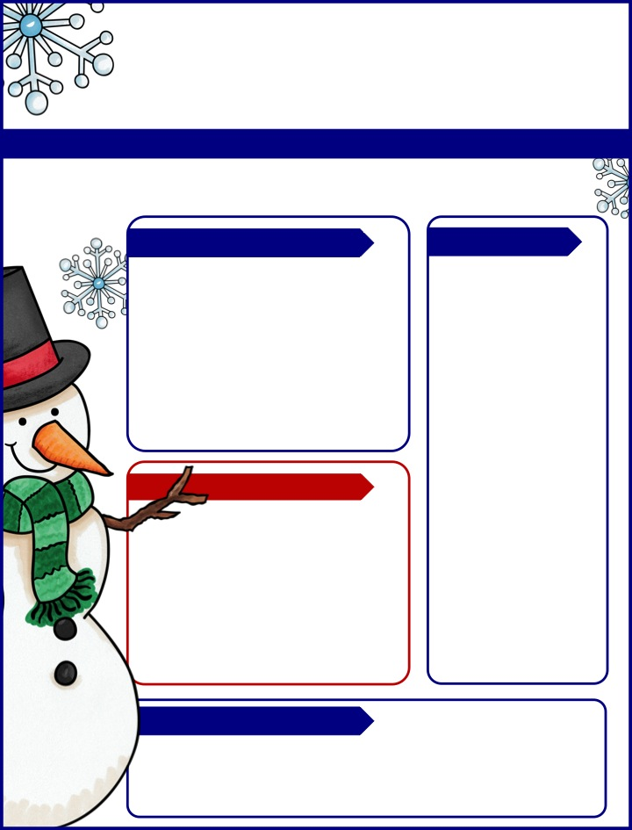
Marsh Mail
The Week of December 11th
Email: marshs1@parklandsd.org
Phone: ​(610) 351-5830 ext. 24107 Website: marshs1.weebly.com
Upcoming Events
Reminders
12/12: 5th Grade Band Concert (No Math HW)
12/13-12/18: Unit 2 Wonders Testing
12/21: Festive Sweater Day
The winter break is quickly approaching. If you would like a winter work packet for your child to do during this break, please let me know and I can send one home. Winter break and summer break are two times of year we can see regression in skills. To avoid the winter and summer slide, I provide work packets that students can do to practice skills. Please let me know if you would like a work packet for your child.
Reminders
Our Learning
Writing: We are typing our final drafts of our explanatory essays. Keep an eye out for them on SeeSaw!
Reading: Unit 2 testing begins this week.
Math: Chapter 6: Fractions
At-Home Practice
Read 20 minutes each night.
Practice multiplication and division math facts.

